Slide 1
ANALYSIS OF GREEN ENERGY
(IN EUROPE)
Professor Vijayalakshmi Saravanan
Data Analysis, Decision Making, and Visualization
CSC557-U15-92793
Jose David Cortes
Bhulakshmi Kunchala
https://github.com/josedavidcortes-git/final_data/

Slide 2
01
Dataset
Agenda
02
Python Data Analysis
03
Tableau
04
Repository

Slide 3
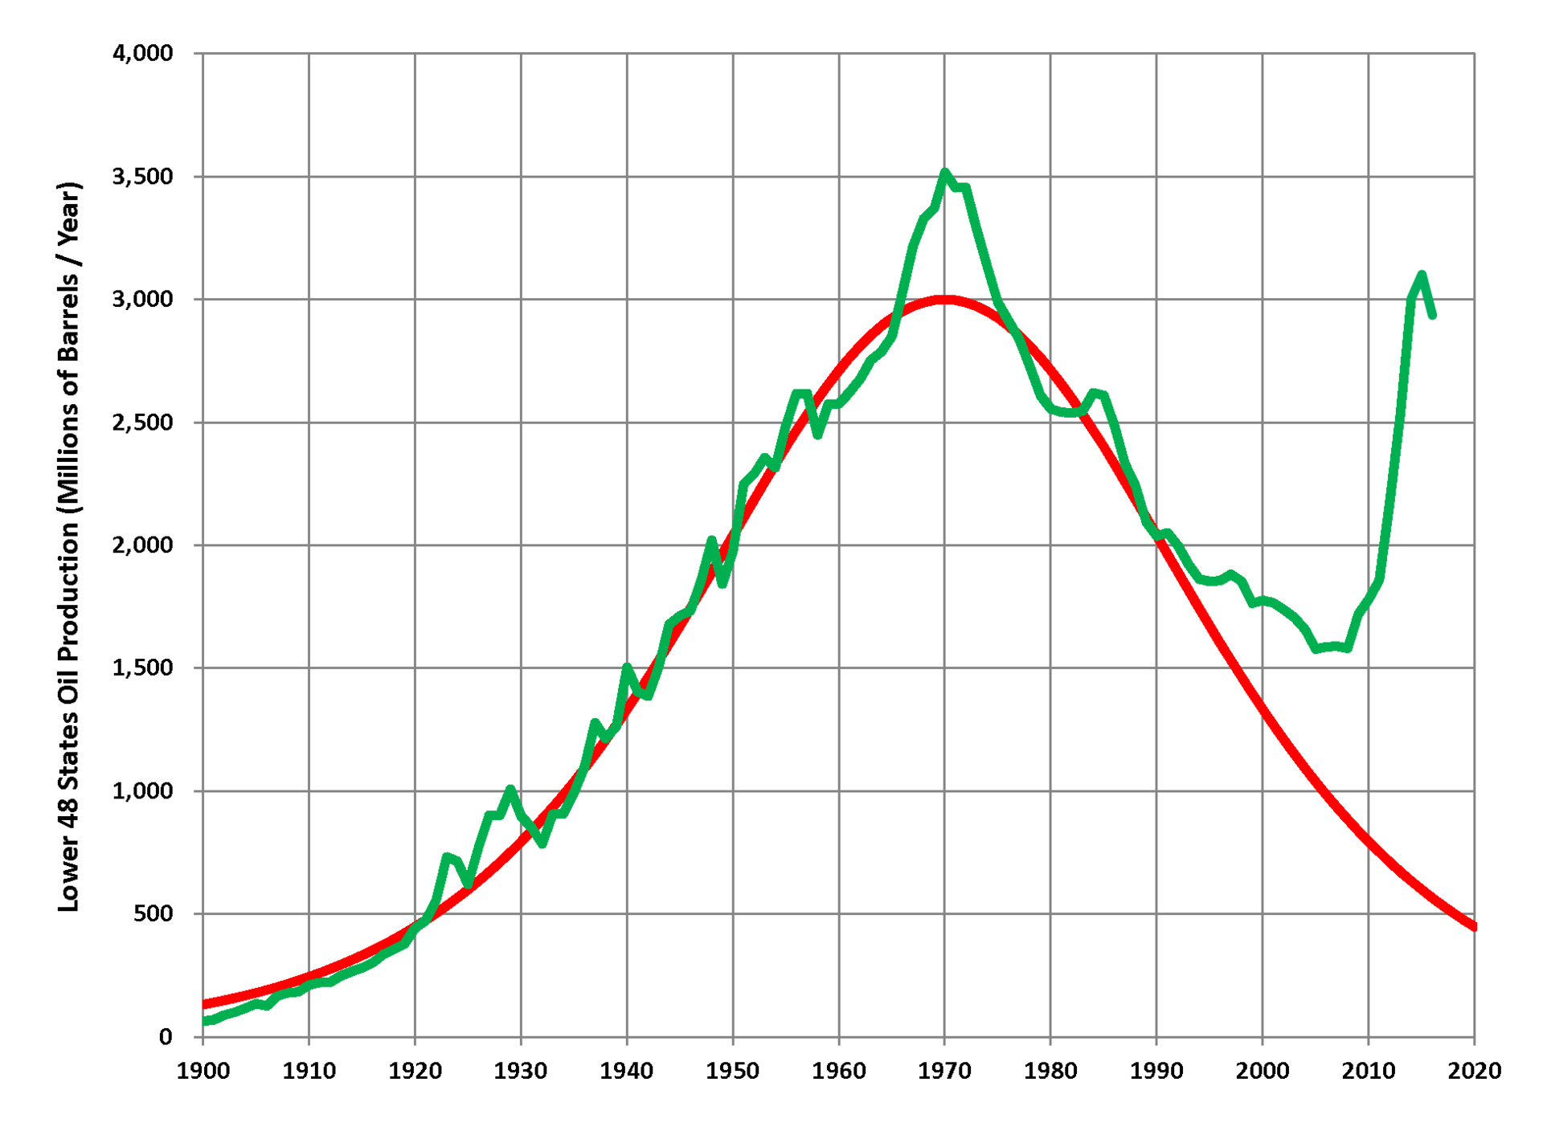
Hubbert Peak theory
What do you think about the future?
Can we predict scenario or scenarios?
1956
Prediction Fail
Just “one” empirical scenario
https://en.wikipedia.org/wiki/Hubbert_peak_theory

Slide 4
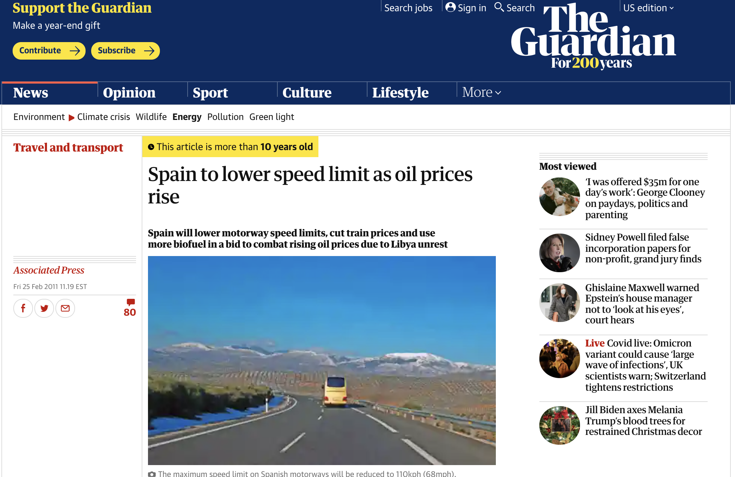
Predict crisis
Content Here
Easy to change colors, photos and Text.
Content Here
Easy to change colors, photos and Text.
Content Here
Easy to change colors, photos and Text.
Content Here
Easy to change colors, photos and Text.
https://www.theguardian.com/environment/2011/feb/25/spain-speed-limit-oil-prices

Slide 5
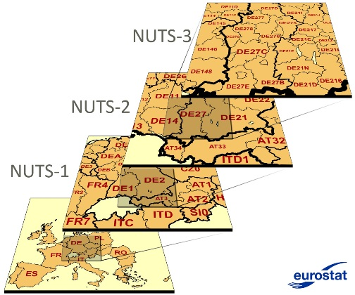
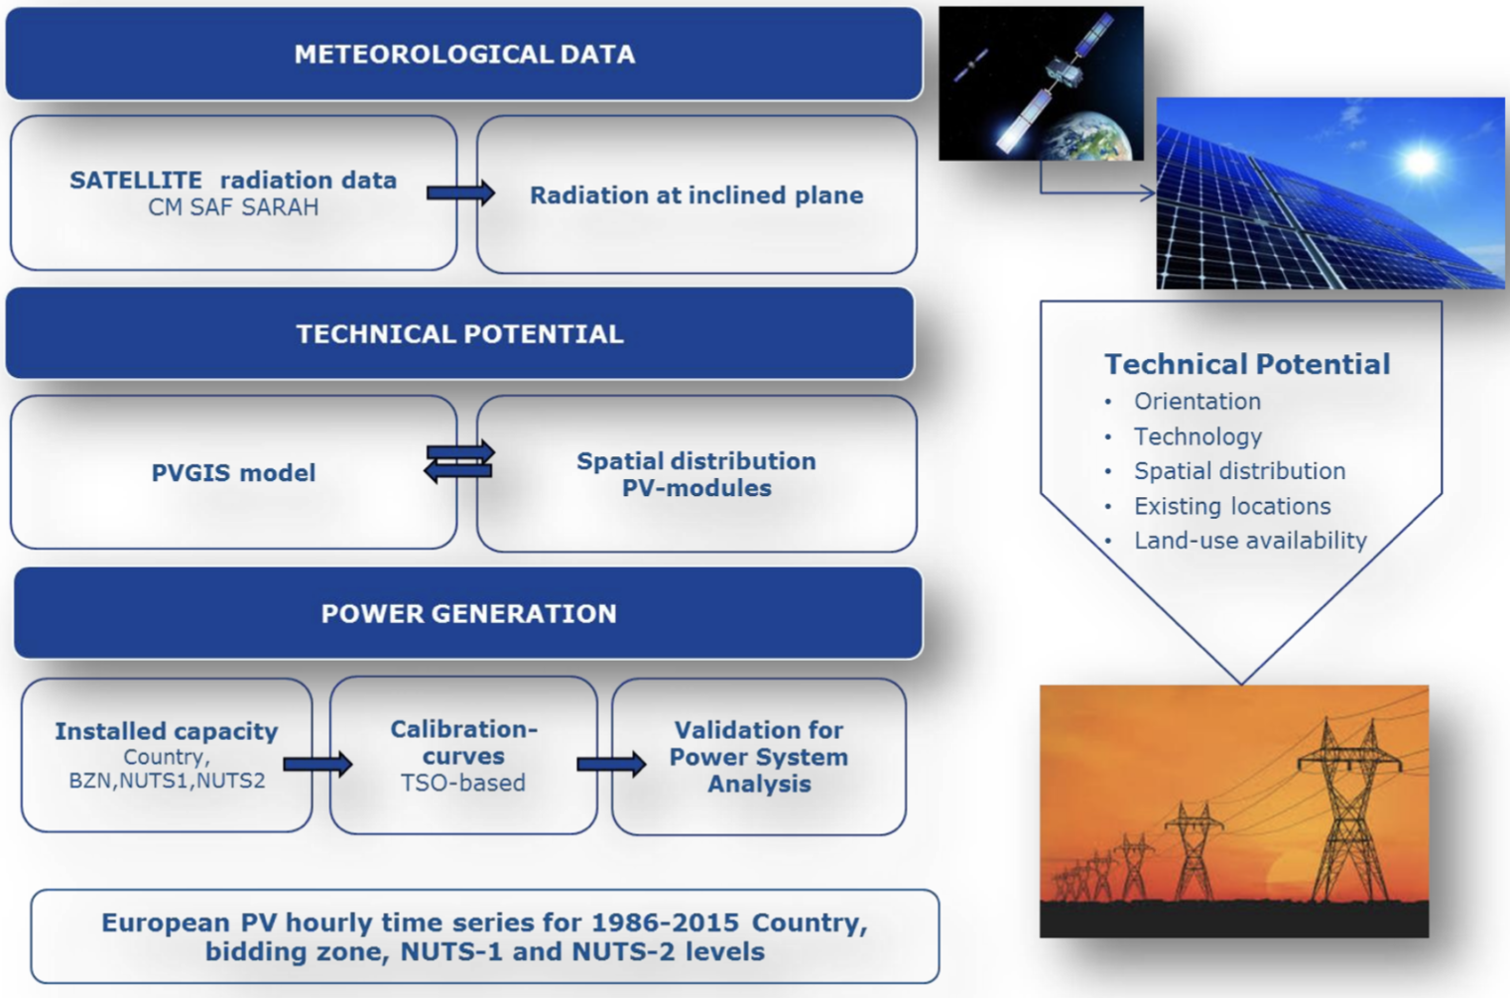
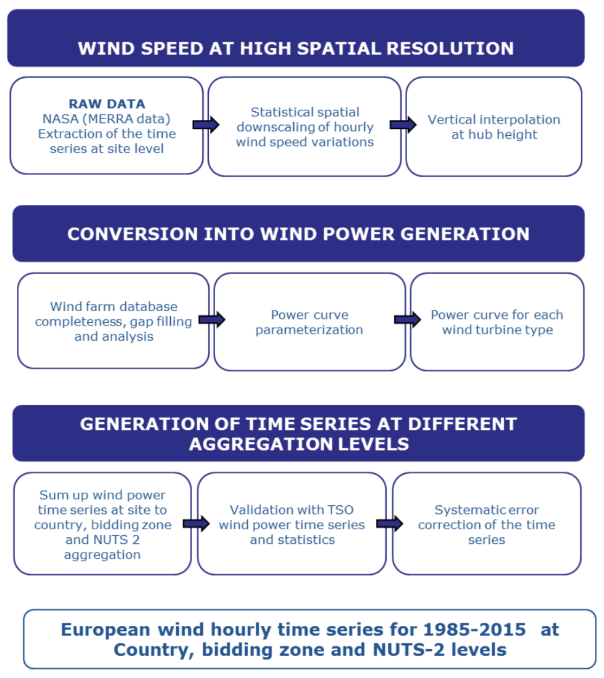
01 Dataset EMHIRES
https://zenodo.org/record/4803353#.YaaTIfHMI-R
01
02
Wind
Solar

Slide 6
01 dataset (Timeline)
Green Deal
EMHIRES
Solar & Wind.
Public & Free.
Green Deal
Green Deal
2015
Dataset
2030
1986
2020
2050
EMHIRES
No public.
You must apply to get this information. No Free.
https://ec.europa.eu/info/strategy/priorities-2019-2024/european-green-deal_en

Slide 7
02 Data Analysis (Python)
01
02
03
Data Clusters
Data Analysis
Prediction

Slide 8
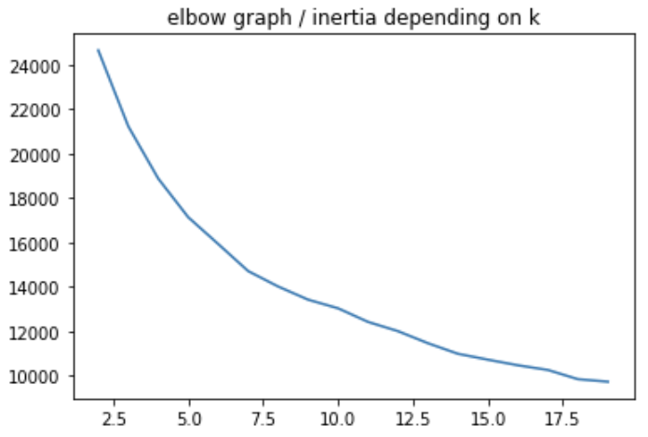
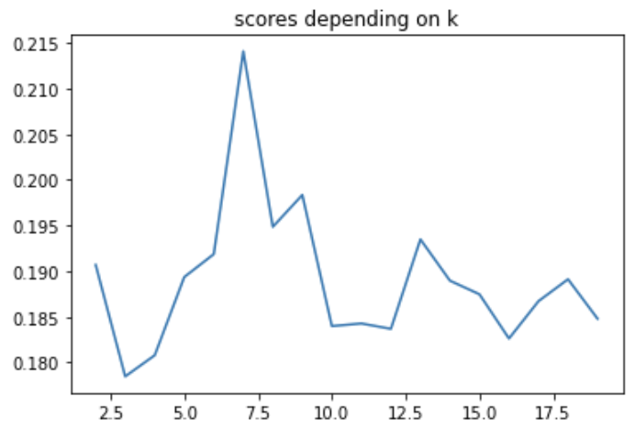
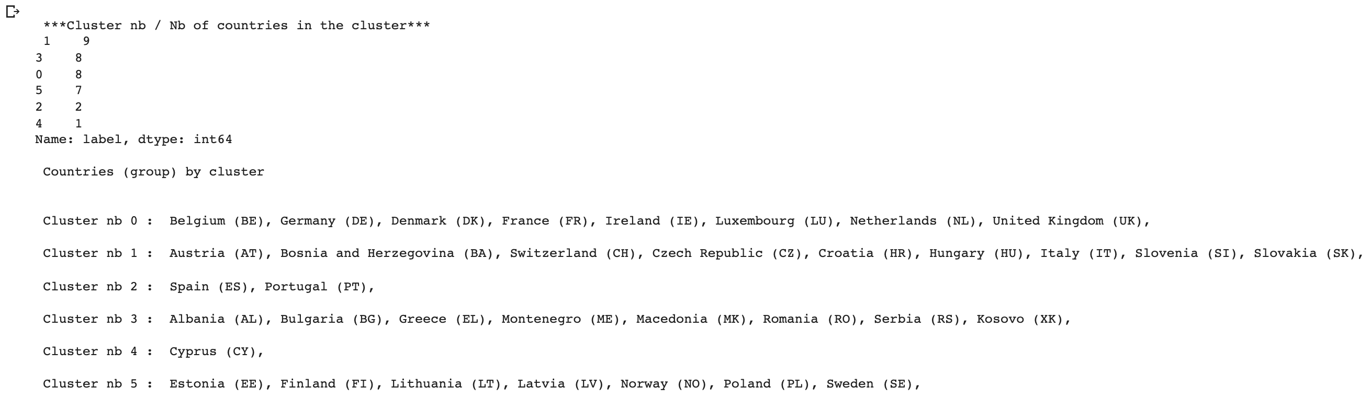
02 Data Analysis (Python)
01
Data Clusters
KMean model

Slide 9
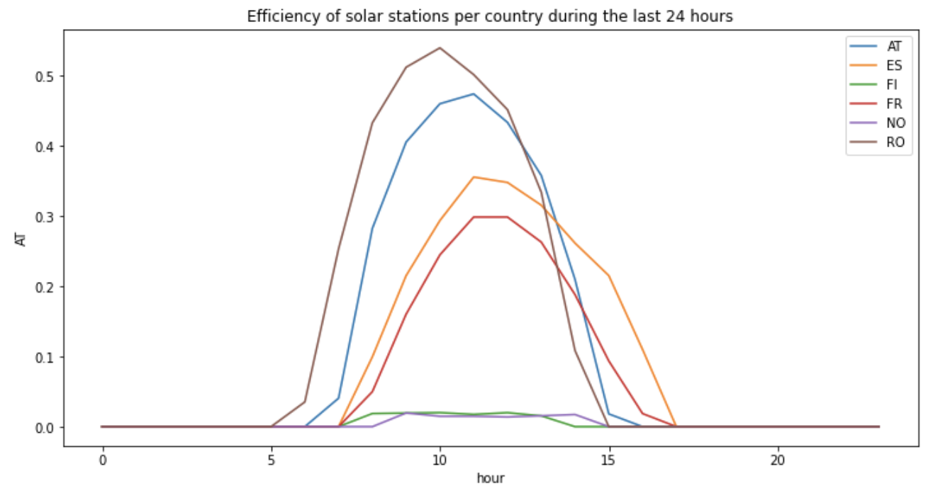
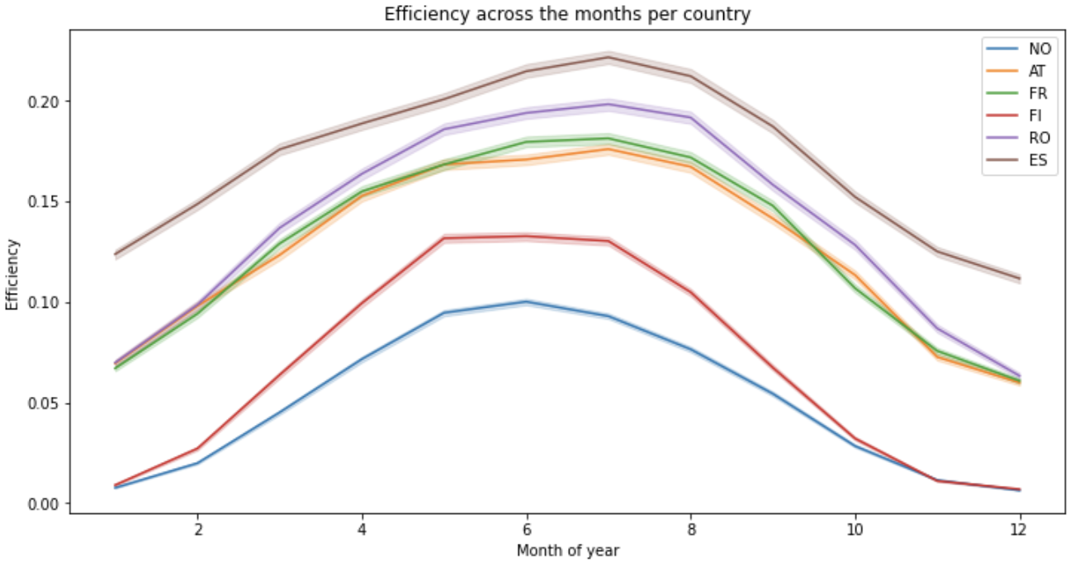
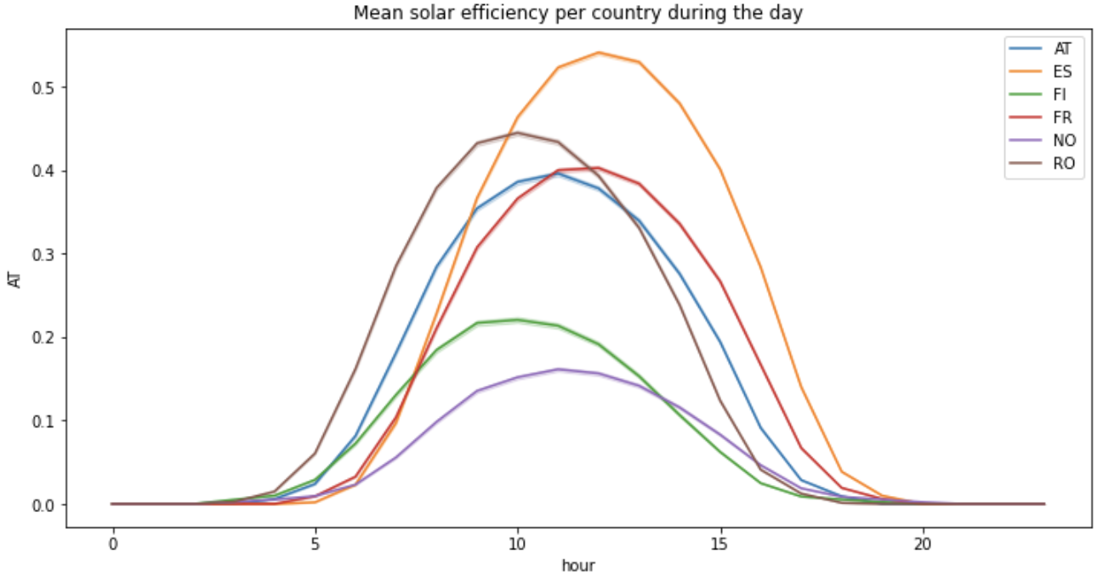
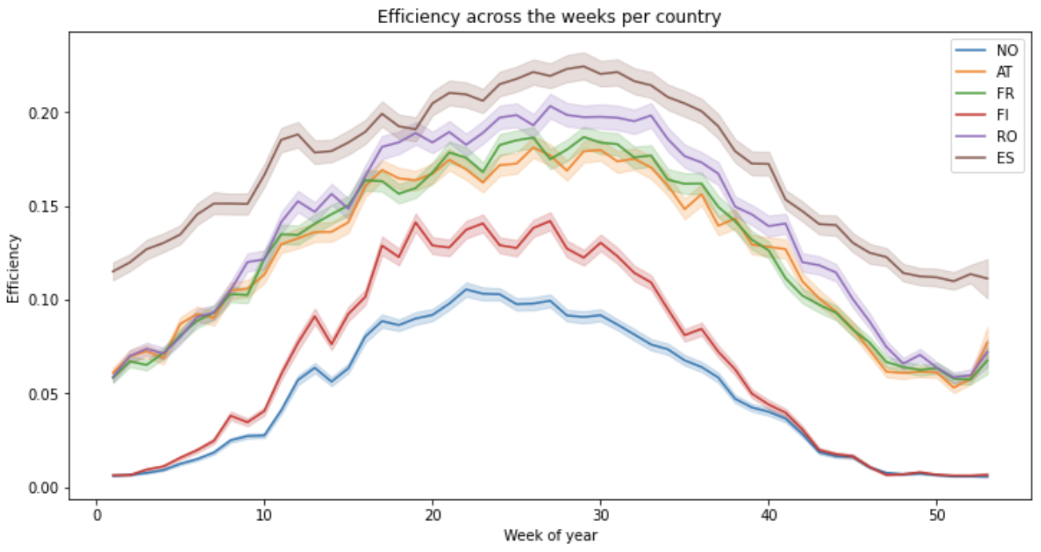
02 Data Analysis (Python)
02
Data Analysis

Slide 10
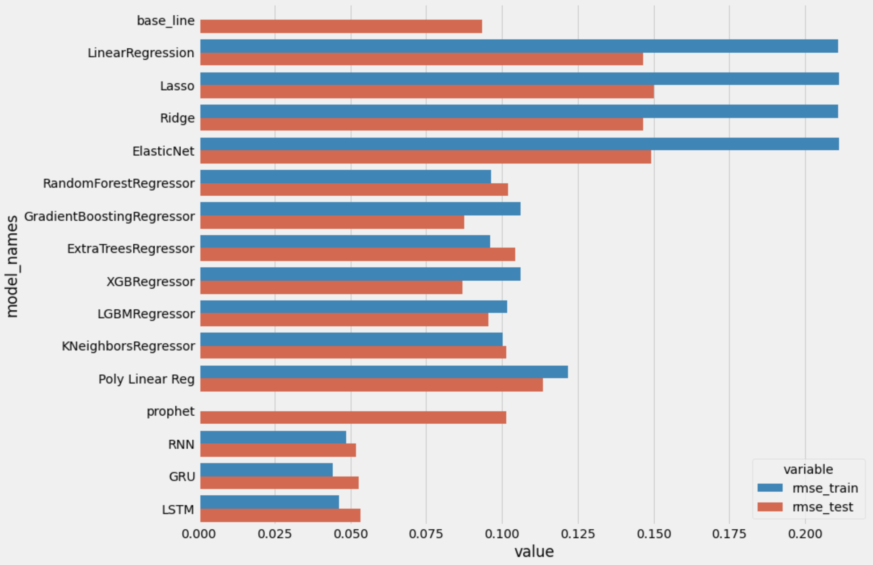
02 Data Analysis (Python)
03
Prediction

Slide 11
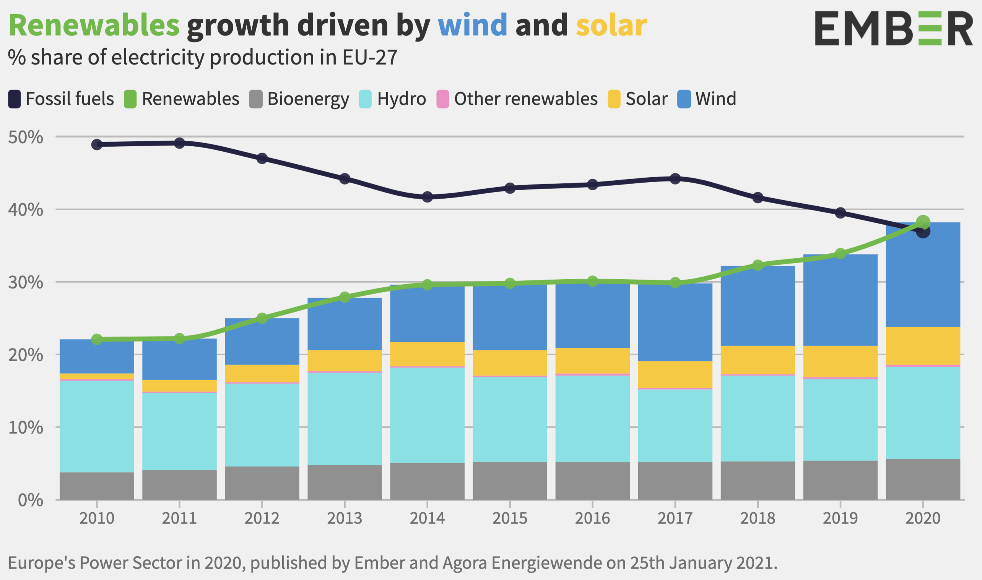

Section Break
Insert the Sub Tittle of Your Presentation

Slide 12
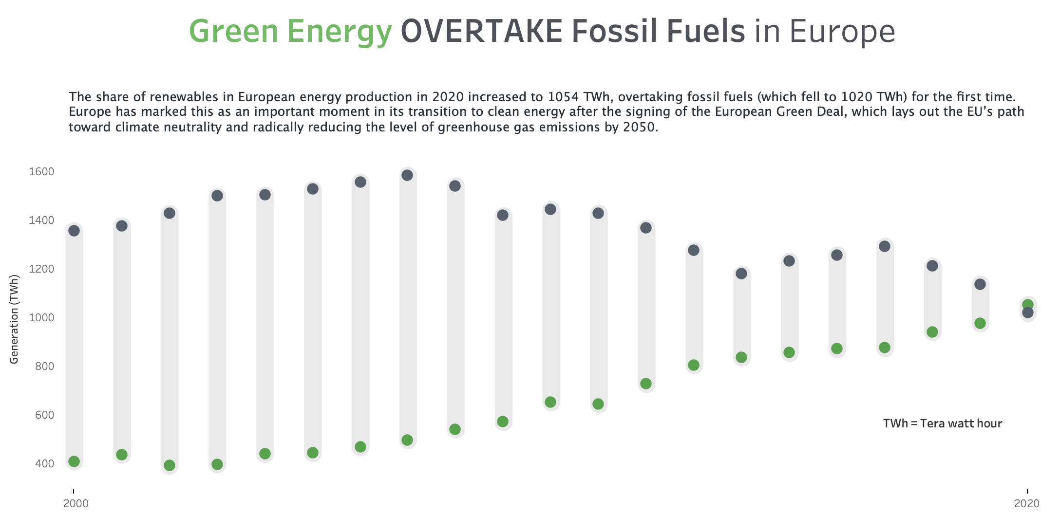

Slide 13
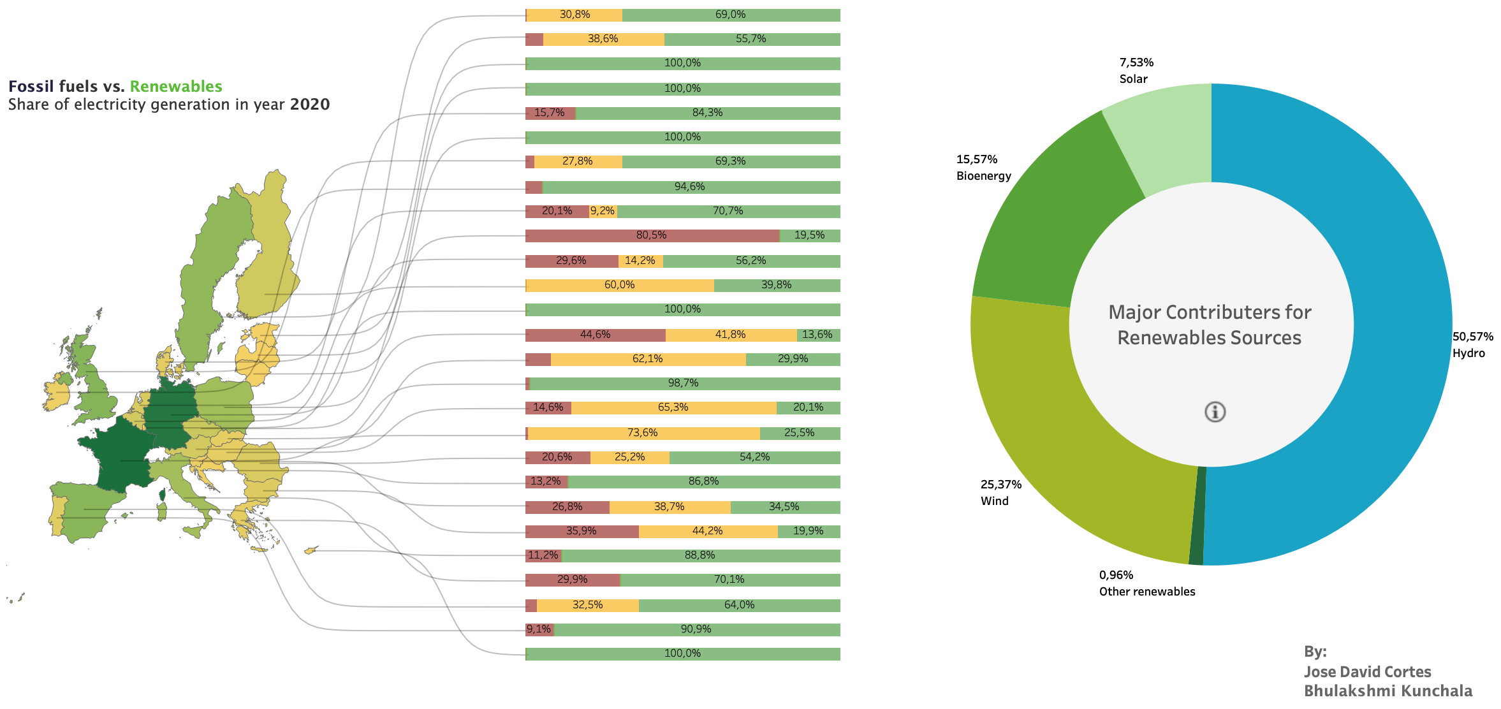

Slide 14
Thank You
Insert the Sub Title of Your Presentation

